Slide 1
Visual Studio Diagnostic Tools
John Koerner
@johnkoerner
https://johnkoerner.com

Slide 2
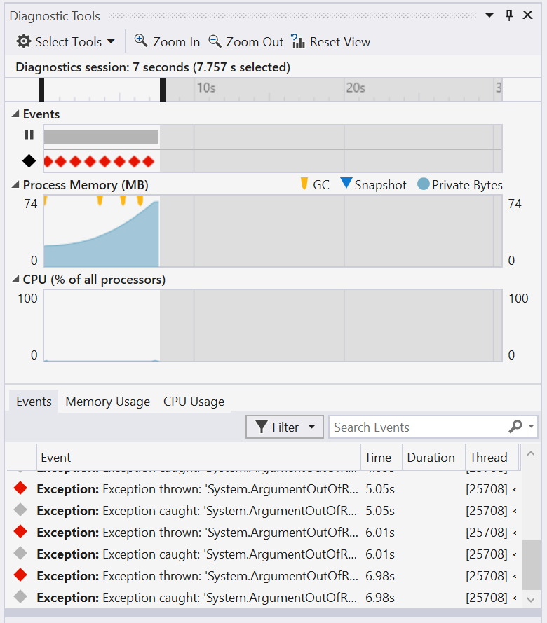
What are the diagnostic tools?
VS 2015 Update 1
Feature | Visual Studio Express | Visual Studio Enterprise
CPU Usage | ✓ | ✓
Memory Usage | ✓ | ✓
Exception Events |  | ✓
Historical Debugging |  | ✓

Slide 3
Demo

Slide 4
Contact Me
https://johnkoerner.com
https://github.com/johnkoerner
@johnkoerner

